Slide 1
Deep Learning Frameworks
February 11, 2020
Jesse Spencer-Smith, Chief Data Scientist Data Science Institute Vanderbilt University

Slide 2
AI
Machine Learning
Expert Systems
Gradient Boosting
Deep Learning
Convolutional Neural Networks
General Problem Solver
Random Forest
Neural Nets
Recurrent Neural Networks
Logistic Regression
Transformers
Perceptron
1950 1960 1970 1980 1990 2000 2010 2020
Notes:
Story Intro
AI overview
Capabilities
What enables deep learning?

Slide 3
Bears
path = Path(data/bears)
classes = [teddys,grizzly,black]
data = ImageDataBunch.from_folder(path,
train=".", valid_pct=0.2,
ds_tfms=get_transforms(),
size=224,
num_workers=4).normalize(imagenet_stats)
learn = create_cnn(data, models.resnet34, metrics=error_rate)
learn.fit_one_cycle(4)

Slide 4
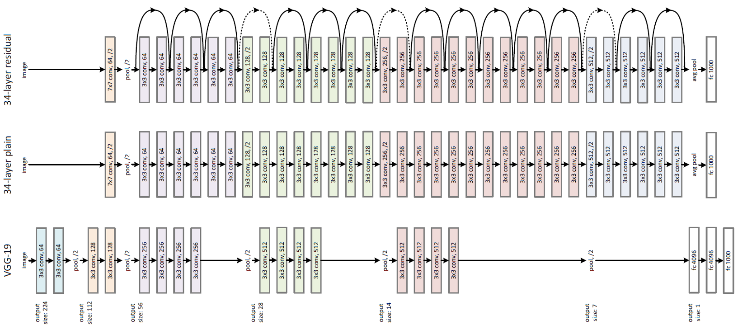

Slide 6
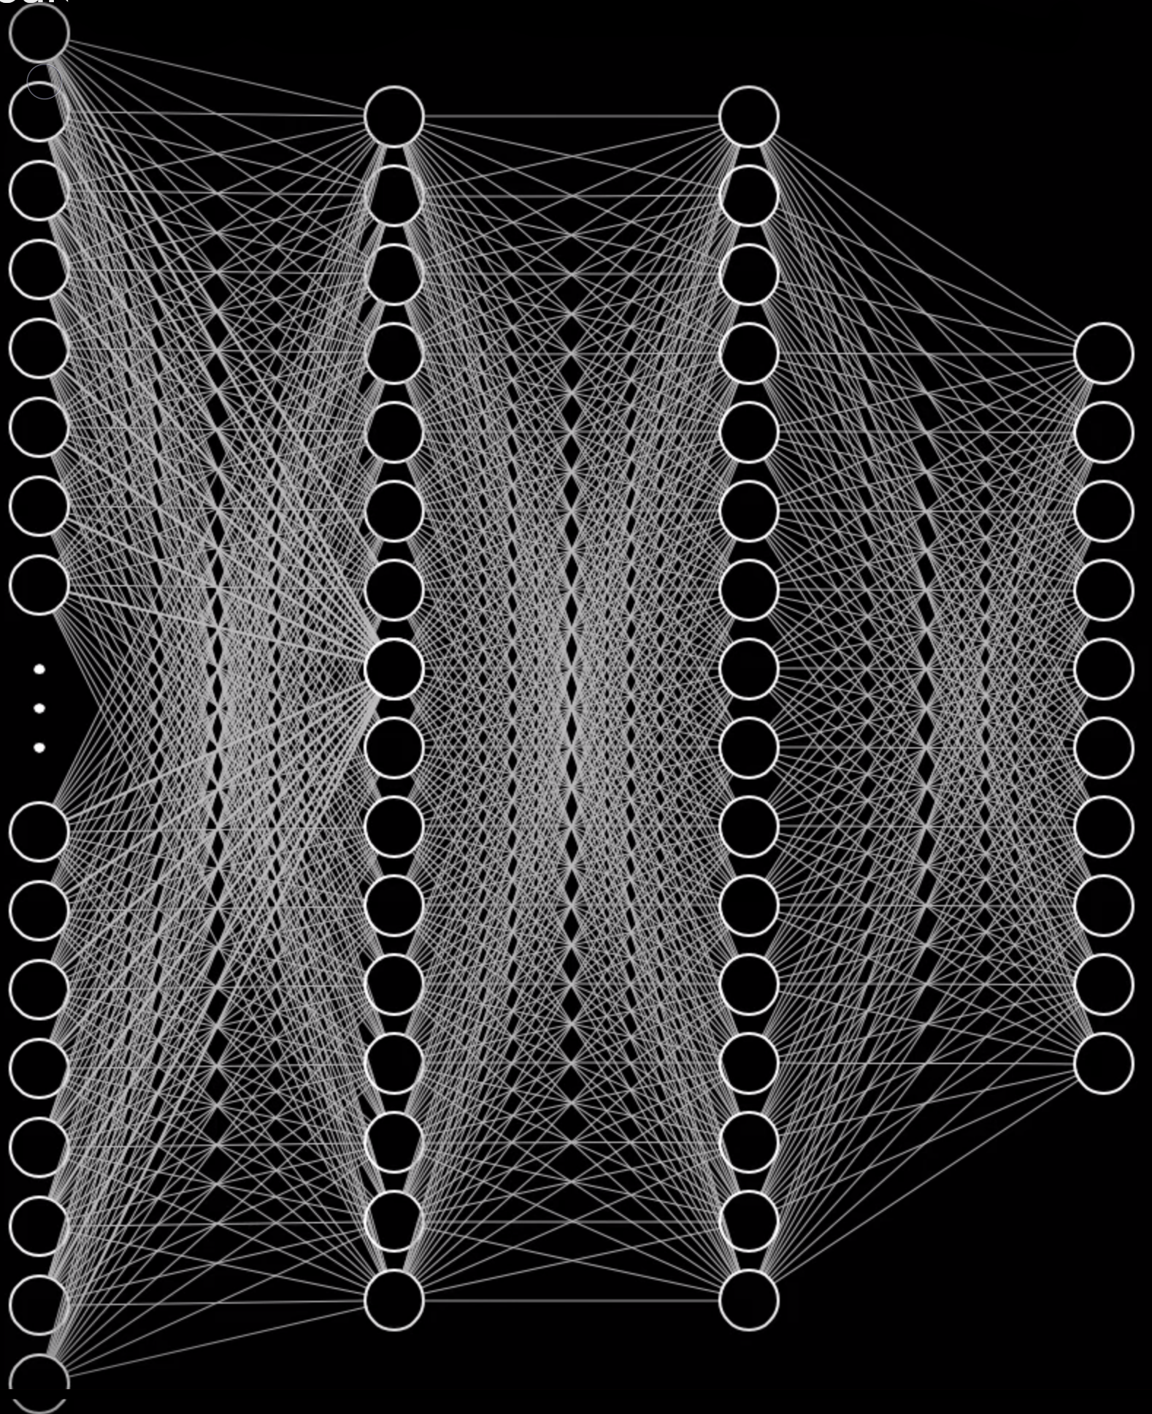
Notes:
What operations?
Inference matrix mult add
Training that + gradient, load many image, 1000’s, 1,000’s
Must do matrix multiplies and adds forward, and to gradient calculations backwards, many times. Batch. Load data quickly.
Hardware
GPU strengths
Limitations (memory)

Slide 7
CPU—Central Processing Unit
GPU—Graphics Processing Unit
6 cores
32GB RAM
Low Latency
Serial processing (parallel with work)
Several operations at once
Many opcode
4,352 CUDA cores
11GB RAM
High Throughput
Parallel processing by design
Thousands of operations at once
Restricted opcode set
Tensor cores
Multiple cards
NVLink
Notes:
So, need to be able to quickly to matrix mult, add, forward
Quickly calc gradients back
What hardware do you need?
Hardware
GPU strengths
Limitations (memory)
Technical overview (single card, multiple cards, shared memory)
More cards, doesn't solve memory footprint
nvidia, nvlink
Why not do everything?
Limited opcodes
Limited memory
Very difficult to program
Need framework to handle backend

Slide 8
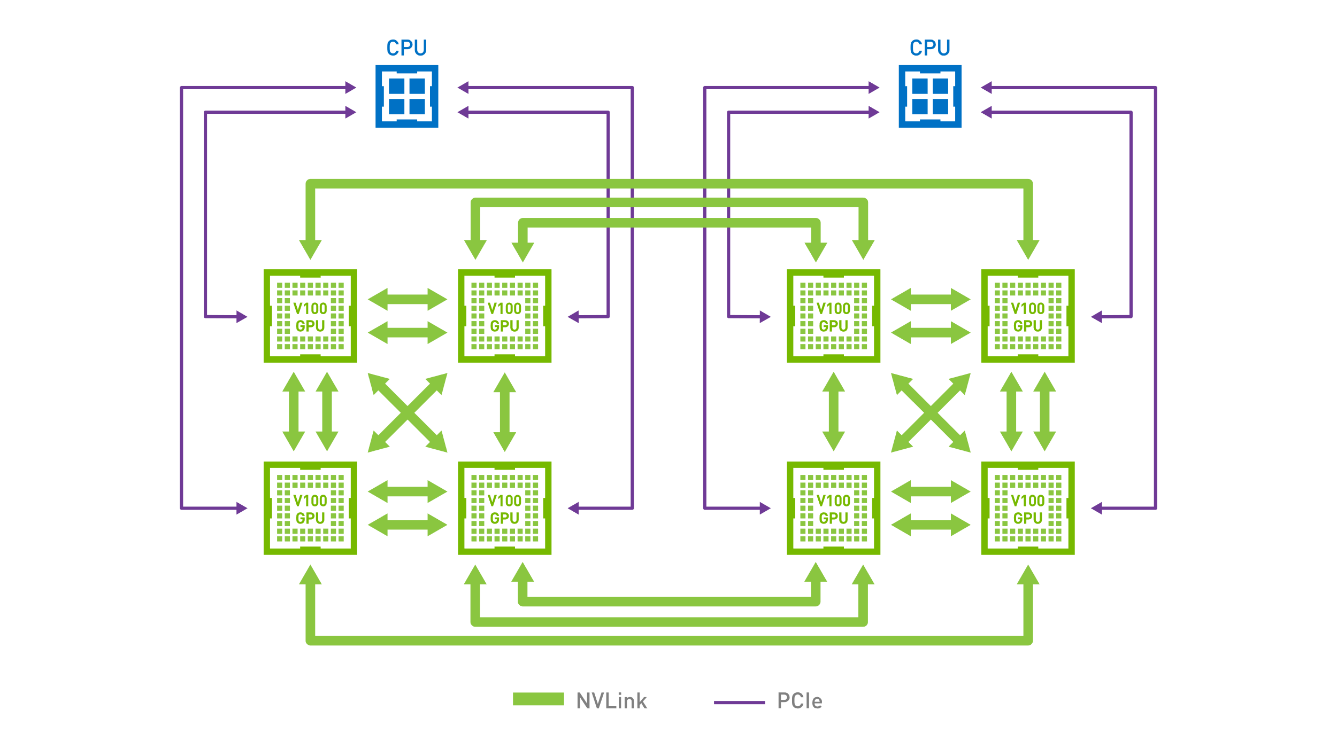

Slide 9
Notes:
Raw horsepower. Access is very painful. Solves some, but not all.
Problems remaining:
Access to GPUs, orchestrating data movement, processing
calculating massive number of gradients
Describing network
Two solutions
Static. Limited. Know all at onces
Dynamic. Calculate partial gradients as you sweep forward, and record what you have. Use chain rule and roll back.
Autodifferentiation.

Slide 10
Deep Learning Frameworks
Provide
simplified access to power of GPUs
high-level API to express processing pipelines
representation of deep neural networks—graphs
simplified movement of data to and from GPU memory
methods to address backpropagation (gradients calculation)
static graph
dynamic graph (autodifferentiation)

Slide 11
PyTorch
Tensorflow
Pythonic
Integrates with rest of ecosystem
Growing adoption
Dynamic graph based
Speed can be slower (some differ)
Translate to C++, Open Neural Network Exchange (ONNX) export
Dominant in research
Autodifferentiation
Called from Python
Debugging requires active session
Widespread adoption
Dynamic graph as of TF 2.0 (eager execution)
Highly optimizable
Many paths to production with specialized tools and platforms
Dominant in production
Autodifferentiation

Slide 12
fast.ai Framework
Sits atop PyTorch
Provides sensible presets for common parameters
Provides high-level functions to handle repeating complex multi-step procedures
PyTorch-level work can be intermixed

Slide 13
Bears
path = Path(data/bears)
classes = [teddys, grizzly, black] data = ImageDataBunch.from_folder(path,
train=".", valid_pct=0.2,
ds_tfms=get_transforms(),
size=224,
num_workers=4).normalize(imagenet_stats)
learn = create_cnn(data, models.resnet34, metrics=error_rate)
learn.fit_one_cycle(4)

Slide 14

Pretrained Models
Recall
Most projects start with a pretrained network
New pretrained networks are often quickly translated
See https://github.com/onnx/models
NLP

Slide 15
Going Beyond Deep Learning
Probablistic programming
Optimization
Differentiable programming

Slide 16
Going Beyond Deep Learning
Probablistic programming
Optimization
Differentiable programming

Slide 17
Notes:
Raw horsepower. Access is very painful. Solves some, but not all.
Problems remaining:
Access to GPUs, orchestrating data movement, processing
calculating massive number of gradients
Describing network
Two solutions
Static. Limited. Know all at onces
Dynamic. Calculate partial gradients as you sweep forward, and record what you have. Use chain rule and roll back.
Autodifferentiation.

Slide 18
Possibilities with Differentiable Programming
Apply deep learning approach to any differentiable function or program
Building block approach using parameterized functional blocks
Parameterized
Automatically differentiated
Trainable / optimizable
Better, faster results with fewer parameters.
Build models on first principles

Slide 19
Applications of Differentiable Programming
Dynamical systems
Physics models
Bridge between scientific computing and deep learning

Slide 20
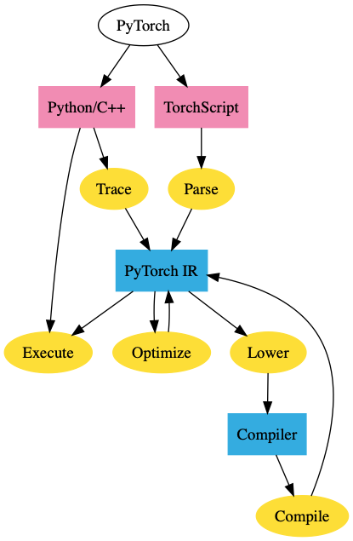

Slide 21
Swift for TensorFlow
LLVM-based (Designed by Chris Lattner)
Incorporate differentiable programming deeply
Differentiate arbitrary code
No calls to an API—TensorFlow and Swift intermingle
Code GPU kernels directly in Swift
Notes:
Python: Slow at runtime, poor support for parallel processing (but very easy to use)
C, C++: hard to use (and C++ is slow at compile time), but fast and (for C++) expressive

Slide 22
Compute
Many choices!
Roll your own
Collab
Paperspace
ACCRE

Slide 23
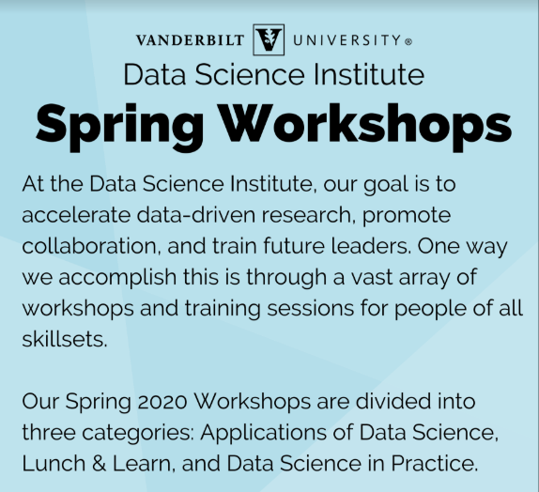
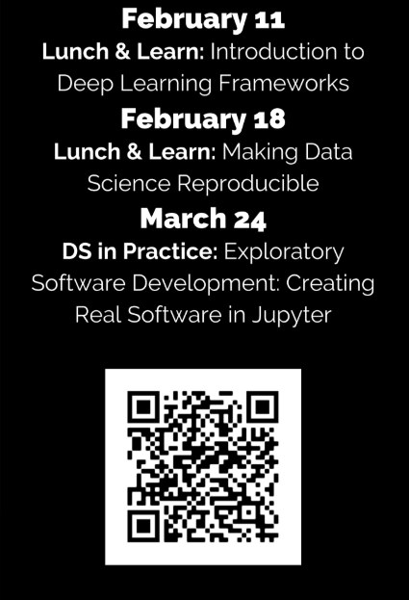
Visit https://www.vanderbilt.edu/datascience/events/data-science-workshops/

Slide 24
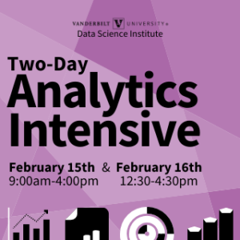
Visit https://www.vanderbilt.edu/datascience/events/data-science-workshops/

Slide 25
NLP Learning Cohort
A Code-First Introduction to Natural Language Processing fast.ai Rachel Thomas
Topics: topic modeling, classification, language modeling, and translation
Approaches:
traditional NLP (including regex, SVD, naive bayes, tokenization) and
neural network (including RNNs, seq2seq, attention, and the transformer architecture)
Email Jesse.Spencer-Smith@Vanderbilt to be added to the Slack organizing channel.

Slide 26
Visit https://www.vanderbilt.edu/datascience/events/data-science-workshops/

Slide 27

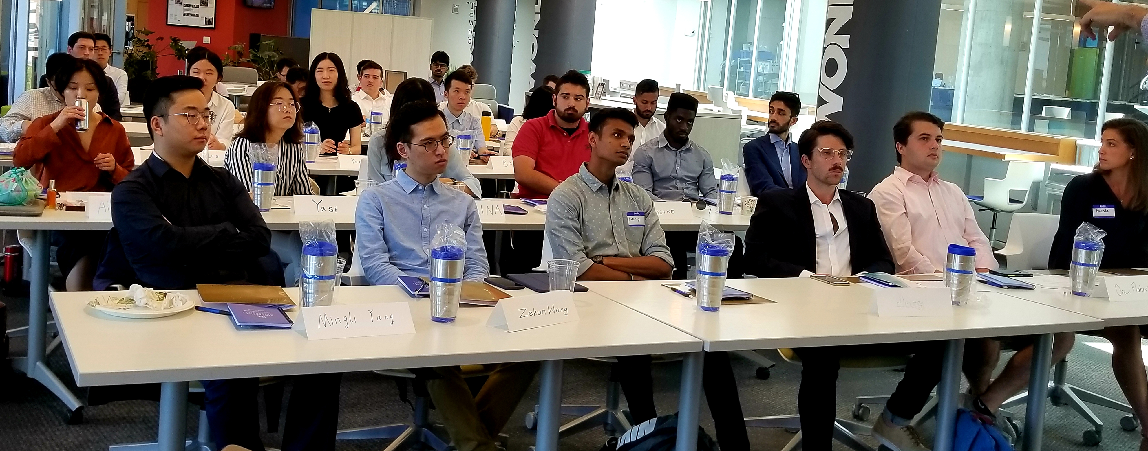
Professional M.S. Program
If you are interested in having summer interns or advising MS capstone projects, come talk to us!

Slide 28
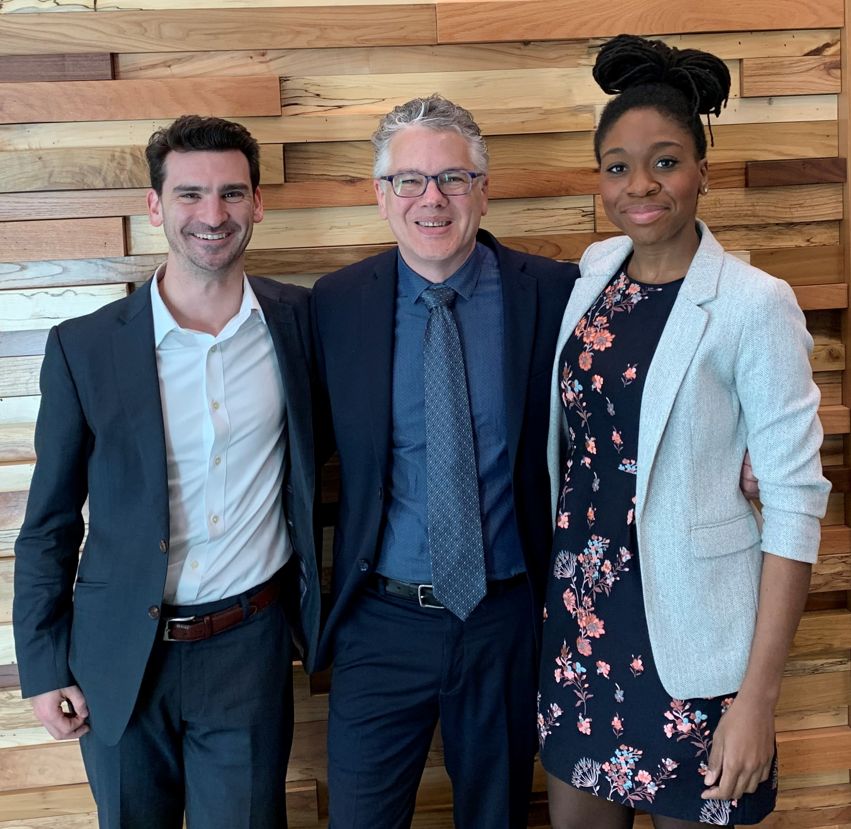
Consulting and research engagements with data science team

Slide 29
www.vanderbilt.edu/datascience/

Slide 30

Slides, resources, and links at https://github.com/vanderbilt-data-science/dl-frameworks

Slide 31
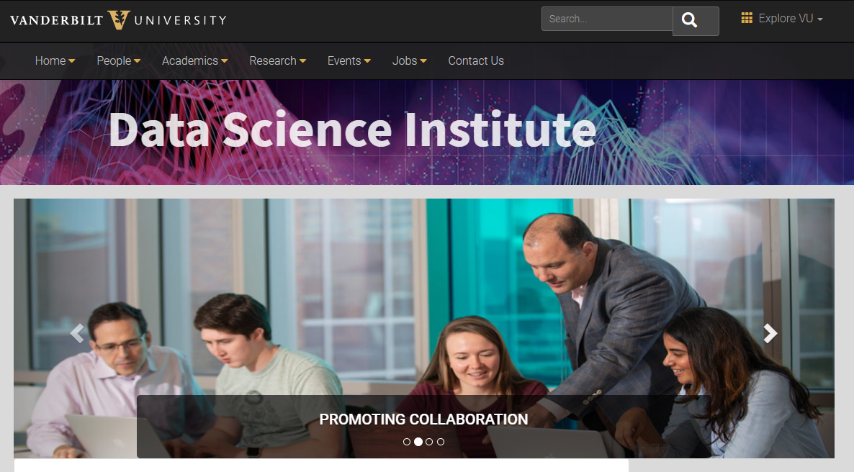

Slide 32
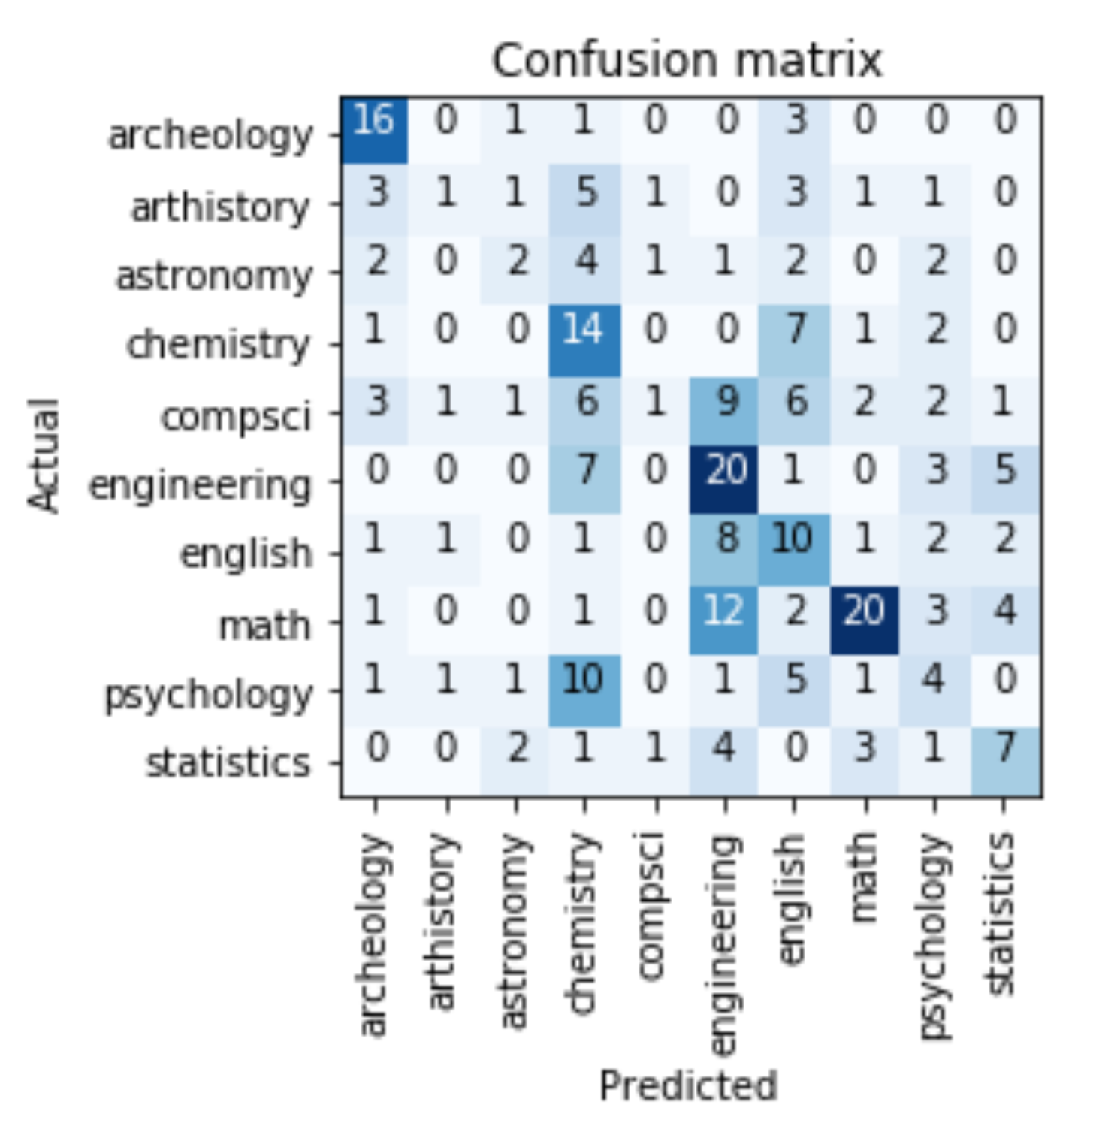
Guess the Area
Correct Answer →
✗
✓

Slide 33
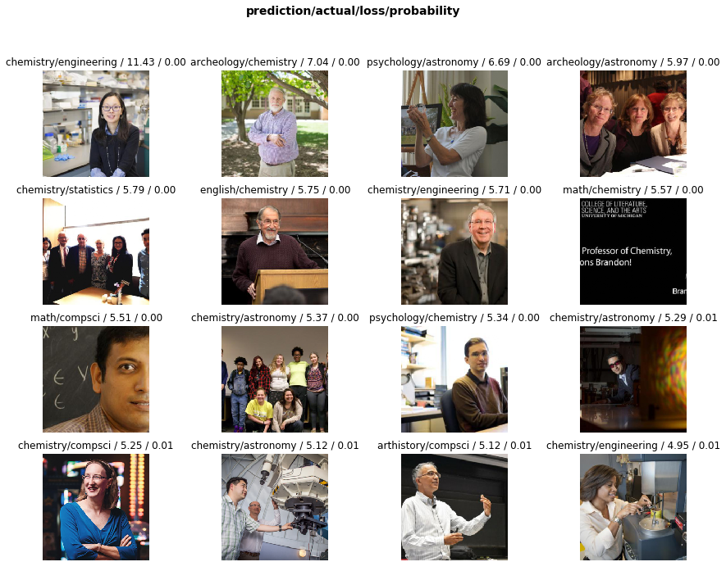
Guess the Area
Correct Answer →
✗
Archeology
Art history
Astronomy
Chemistry
Computer Science
Engineering
English
Informatics
Math
Psychology
Statistics
Model predicted →
✓

Slide 34
Guess the Area
Correct Answer →
✗
Archeology
Art history
Astronomy
Chemistry
Computer Science
Engineering
English
Informatics
Math
Psychology
Statistics
✓
Model predicted →

Slide 35
Guess the Area
Correct Answer →
✗
Archeology
Art history
Astronomy
Chemistry
Computer Science
Engineering
English
Informatics
Math
Psychology
Statistics
✓
Model predicted →

Slide 36
Guess the Area
Correct Answer →
Archeology
Art history
Astronomy
Chemistry
Computer Science
Engineering
English
Informatics
Math
Psychology
Statistics
Model predicted →
✗
✓

Slide 37
Guess the Area
Correct Answer →
✗
Archeology
Art history
Astronomy
Chemistry
Computer Science
Engineering
English
Informatics
Math
Psychology
Statistics
Model predicted →
✓

Slide 38
Professor or Grad Student?
Correct Answer →
Graduate student images: 55
Professor images: 43
Validation set: 17

Slide 40
Thank you!
Visit us at the Data Science Institute, Wond’ry Suite 300
Visit our website https://www.vanderbilt.edu/datascience/
Follow us on Twitter: @VUDataScience
Stop by Data Science Office Hours: Tuesdays, 9-11am (no office hours next week)
Interested in a Deep Learning Workshop (followed by fast.ai DL1 cohort)? E-mail jesse.spencer-smith@vanderbilt.edu

Slide 41
Bears Professors
path = Path(data/bears)
classes = [teddys, grizzly, black] data = ImageDataBunch.from_folder(path,
train=".", valid_pct=0.2,
ds_tfms=get_transforms(),
size=224,
num_workers=4).normalize(imagenet_stats)
learn = create_cnn(data, models.resnet34, metrics=error_rate)
learn.fit_one_cycle(4)
path = Path(data/professors)
classes = [archeology, arthistory, astronomy, chemistry, compsci, engineering, english, math, psychology, statistics]
data = ImageDataBunch.from_folder(path,
train=".", valid_pct=0.2,
ds_tfms=get_transforms(),
size=224,
num_workers=4).normalize(imagenet_stats)
learn = create_cnn(data, models.resnet34, metrics=error_rate)
learn.fit_one_cycle(4)

Slide 42
Bears Professors
path = Path(data/bears)
classes = [teddys, grizzly, black] data = ImageDataBunch.from_folder(path,
train=".", valid_pct=0.2,
ds_tfms=get_transforms(),
size=224,
num_workers=4).normalize(imagenet_stats)
learn = create_cnn(data, models.resnet34, metrics=error_rate)
learn.fit_one_cycle(4)
path = Path(data/professors)
classes = [archeology, arthistory, astronomy, chemistry, compsci, engineering, english, math, psychology, statistics]
data = ImageDataBunch.from_folder(path,
train=".", valid_pct=0.2,
ds_tfms=get_transforms(),
size=224,
num_workers=4).normalize(imagenet_stats)
learn = create_cnn(data, models.resnet34, metrics=error_rate)
learn.fit_one_cycle(4)

